Slide 1

Family Dinneroo
Dish Analysis
December 2025

Slide 2
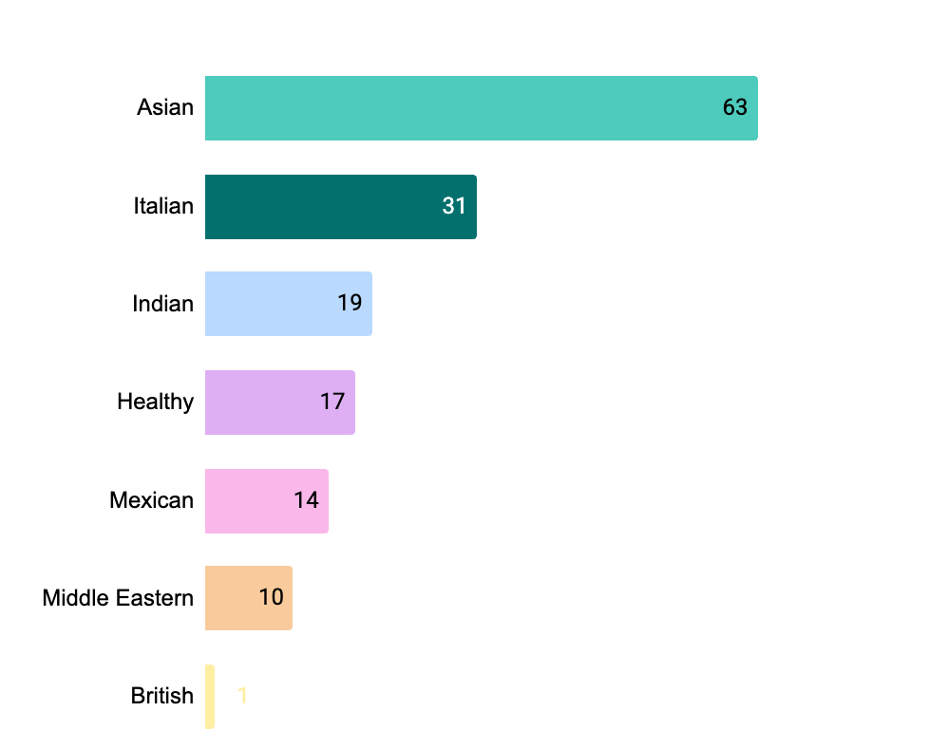
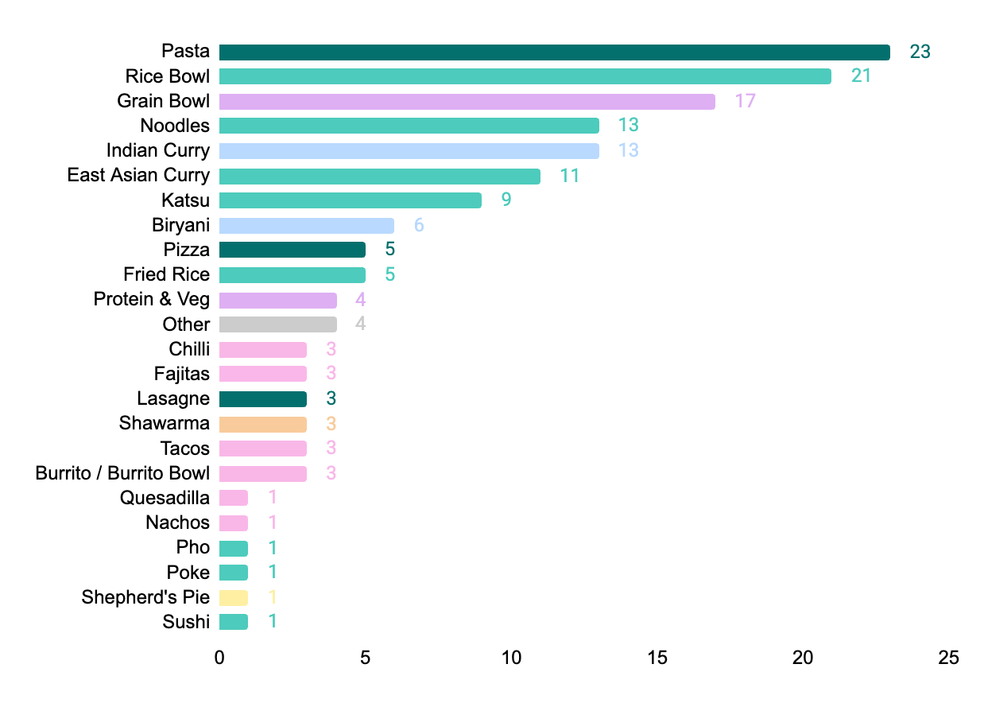
In aggregate, we offer c.155¹ Family Dinneroo dishes, with a strong skew towards Asian and Italian cuisines and dish groups
Dish by Cuisine (# Dishes)
As at 12-Dec
Dish by Dish Group² (# Dishes)
As at 12-Dec
1. Dish counts are based on the number of listed items. Where bundles offer a choice of 2+ distinct dish types (e.g. noodle dishes, rice bowls, or curries), each option is counted as a separate item.
2. Colours indicate the predominant cuisine. This mapping is not one-to-one; e.g. “Grain Bowls” appear under both “Healthy” and “Middle Eastern” cuisines.

Slide 3
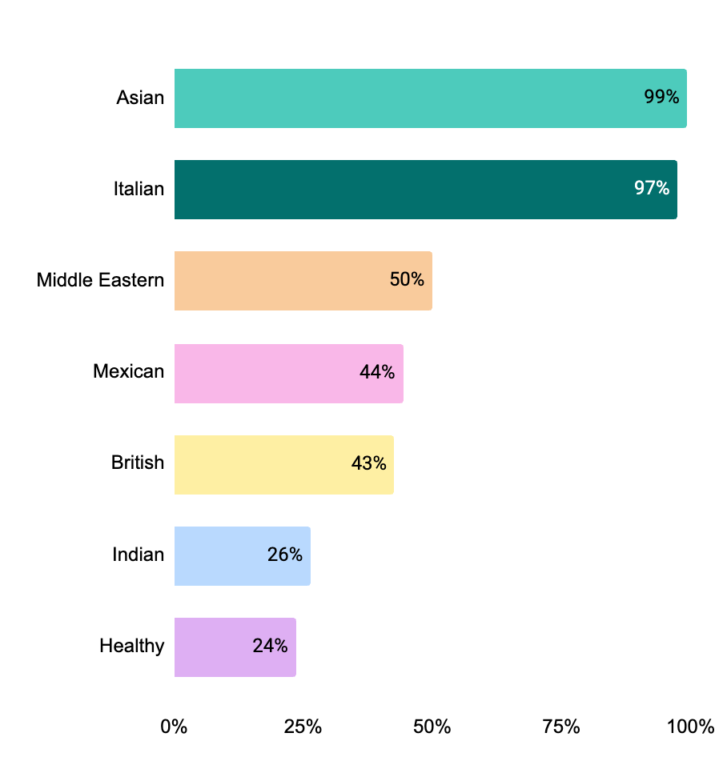
At the zone level, Asian and Italian continue to dominate on both breadth and depth of coverage
Zone Cuisine Coverage (% of Active Zones with ≥1 Dish per Cuisine)
As at 12-Dec
Average Number of Dishes per Zone
(Zones with ≥1 Dish Only)
14
9
3
5
1
5
6
Asian and Italian cuisines are available in almost all active zones (≥97%) and offer strong depth (9+ dishes average per cuisine). Coverage and choice are already robust.
Middle Eastern, Mexican, and British cuisines show mid-to-low availability, present in only 40–50% of zones; where they do exist, depth is limited (1 British, 3 Middle Eastern average)
This indicates a dual challenge: increase range with existing px in the zones already covered AND onboard new px / sites to extend coverage to the remaining 50-60% of zones.
Indian and Healthy cuisines have the lowest availability (~25% zones; but show relatively good depth (5+ options)
This indicates the primary lever is to onboard new px /sites to increase coverage. There may also be an opportunity to work with multi-cuisine brands (e.g. Bill’s) to expand the Indian and Healthy offerings.

Slide 4
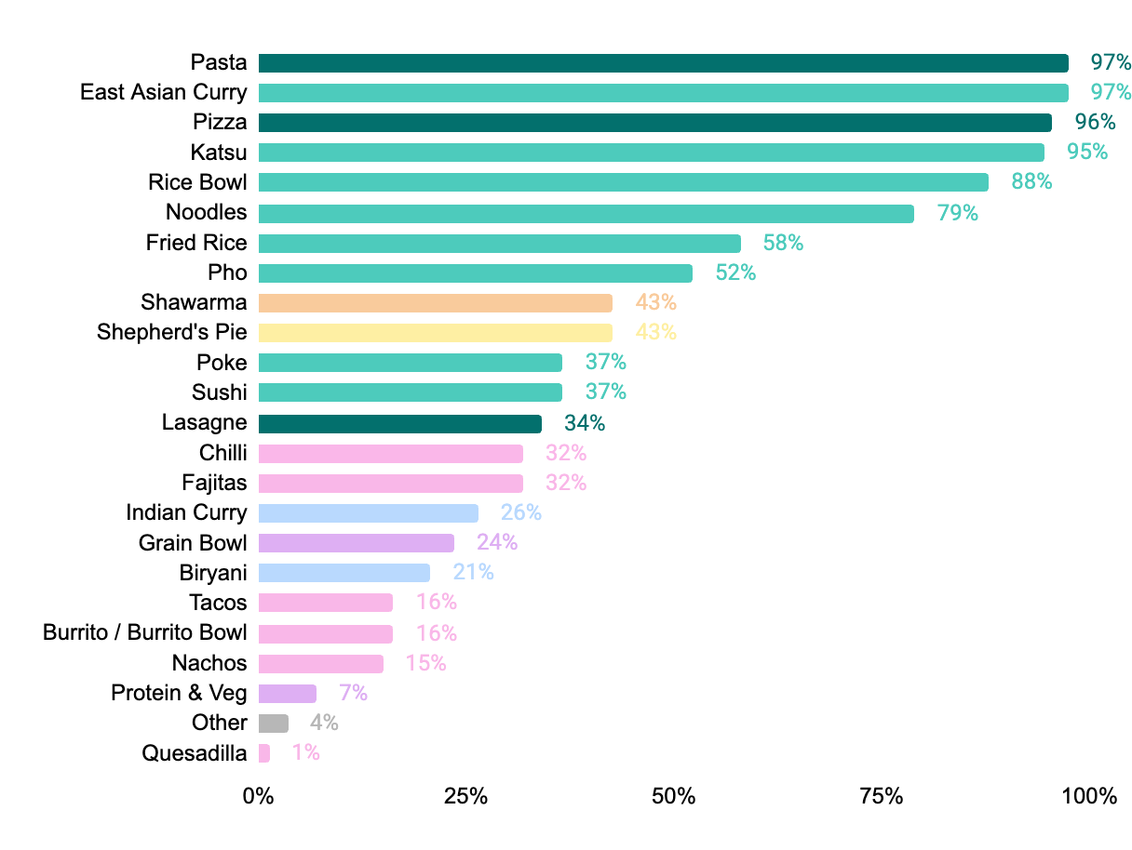
This is reflected at dish level, with East Asian curries, rice, noodles, pasta & pizza well covered, while other dishes remain underrepresented
Zone Dish Coverage (% of Active Zones with ≥1 Dish)
As at 12-Dec
Average Number of Dishes per Zone
(Zones with ≥1 Dish Only)
7
4
2
3
3
3
1
1
3
1
1
1
1
3
3
3
7
2
1
1
1
3
2
1
Asian and Italian dishes dominate on both breadth and depth of coverage, with particularly strong representation across East Asian curries, katsu, rice bowls, noodle dishes (Asian) and pasta and pizza (Italian)
Dishes like shawarma and shepherd’s pie have moderate breath driven by px like Bill’s offering them
Lasagne underperforms relative to other Italian staples, despite being a family favourite
Mexican, Indian, and Healthy dishes show constrained breadth of coverage, in part due to the limited geographic footprint of px

Slide 5
We propose a zone MVP of 5+ px, 5+ cuisines, 20+ dishes
5+
Px
Fran to fill out rationale with data on RHS
We should have data that shows variety complaints decrease a lot after 20+ dishes, 5+ px, 5+ cuisines
5+
Cuisines
20+ Dishes

Slide 6
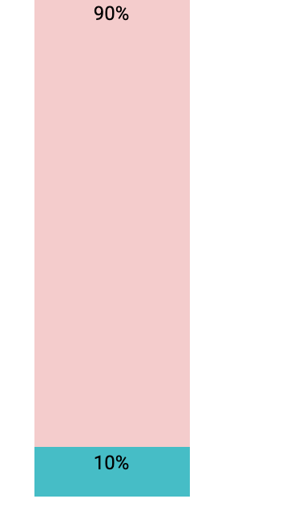
Currently, X zones meet all 3 criteria, with the primary shortfall in cuisine breadth
5+
Px
5+
Cuisines
20+ Dishes
All 3 Criteria
Anna to fill out at end - dummy data

Slide 7
Availability alone is not sufficient - specific dishes also matter; thus, alongside MVP criteria, we have defined a set of minimum dishes by zone
Dish Group | Description | Example Dishes | Requirement
Core Drivers | Dishes with both high customer demand and strong preference | Indian Curry Protein & Veg Noodles | 100% coverage of these dishes
Demand Boosters | Dishes with high demand but weaker preference (customers order them often, but don’t love them yet) | Rice Bowl Pizza Katsu | 50%+ coverage of these dishes Work with PX / Ops to improve quality, recipe or presentation to turn them into Core Drivers.
Preference Builders | Dishes with strong preference but lower demand (loved by those who try them, but not widely discovered) | Shepherd’s Pie Lasagne Fajitas Shawarma | 50%+ coverage of these dishes Invest in merchandising to drive demand.
Anna and Fran to fill out at end - once we have the ‘final’ ratings by dish

Slide 8
We have grouped dishes by overall attractiveness, using a combination of demand signals and customer preference indicators
Grouping | Measure | Description | Source | Weight | Rationale
Demand Indicators | Average Sales per Dish (Existing Dishes Only) | Total orders for the dish divided by the number of times it is listed (accounting for both variations in dish and number of zones it is listed in). | Looker |  | Indicates demand for dish, normalised for availability
 | % of Relevant Zones Where Dish Ranks Top #5 (Existing Dishes Only) | Percentage of zones in which the dish is a top 5 selling item, considering only zones where the dish is available | Looker |  | Indicates demand for dish, normalised for both availability and zone-level demand differences (e.g. higher baseline volumes in Core London zones)
 | Open-Text Requests for Dish (All Dishes)) | [Fran to edit: Number of times a dish is mentioned when customers are asked what they would like to see added] | Post-Launch Survey |  | [Fran to edit: Captures explicit unmet demand for dish]
Consumer Preference Indicators | Deliveroo Rating (Existing Dishes Only) | Average rating for the dish on Family Dinneroo orders | Looker |  | Measures overall consumer satisfaction with the dish
 | Meal Satisfaction Score (Existing Dishes Only) | Percentage of cx who report being “satisfied” or “very satisfied” with the dish | Post Order Survey
 | Repeat Intent Score (Existing Dishes Only) | Percentage of customers who are “likely” or “very likely” to order the same dish again | Post Order Survey
 | Dish Suitability Rating (New Dishes Only) | [Fran to edit: Suitability score out of 5 based on frequency of consumption, difficulty to cook at home, and desire to see the dish on the app] | Pre-Launch R&I Research |  | [Fran to edit: Provides early, survey-driven insight into consumer appeal of dish]

Slide 9
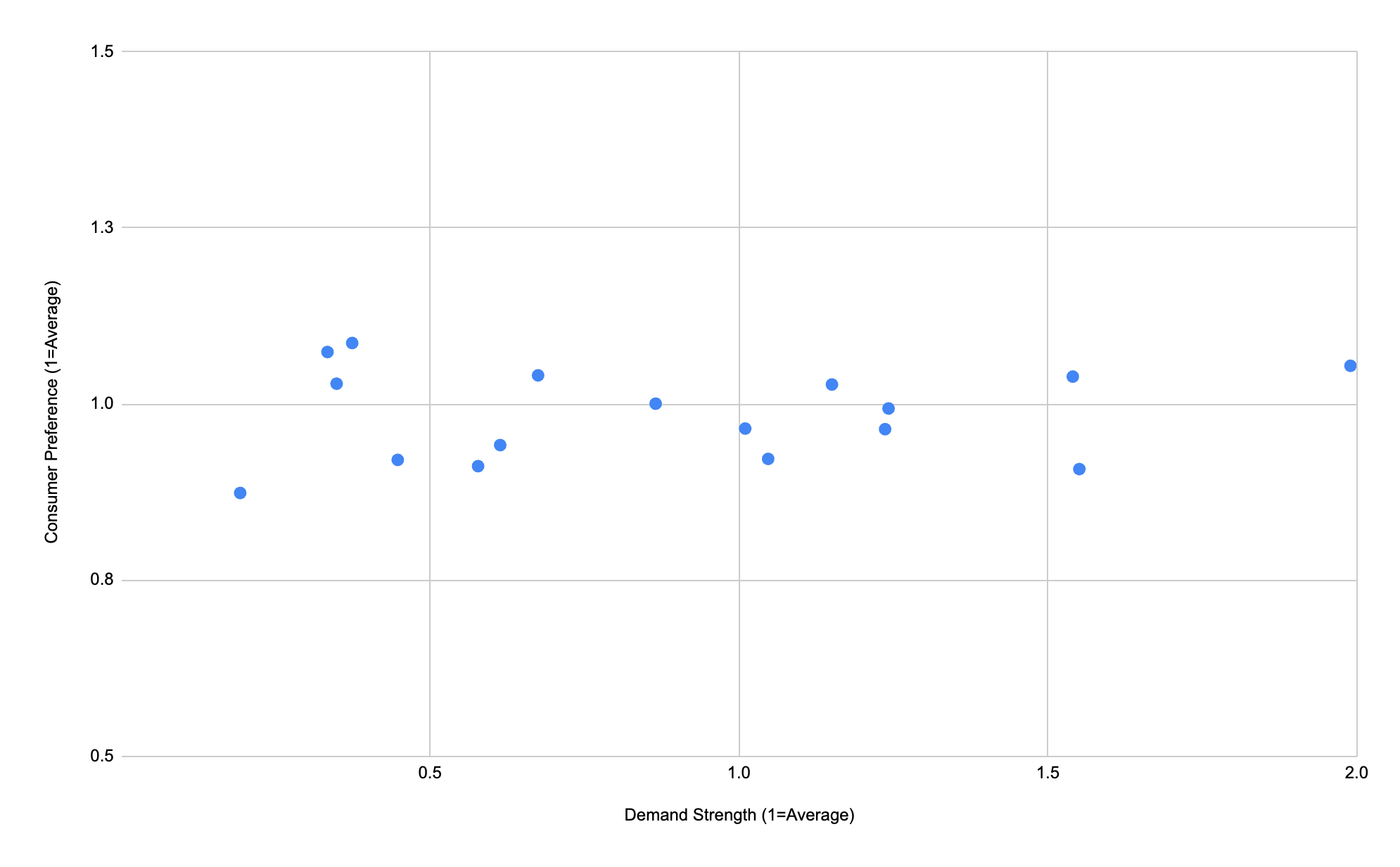
This can be seen in the Demand X Consumer Preference Matrix
Preference Drivers
Core Drivers
To add in naming and commentary once numbers complete
Deprioritised
Demand Boosters

Slide 10
Backup: The data for each indicator was collected, normalised to an index of 1 (where 1=average), and then multiplied by the relevant weighting
 |  | Demand Indicators |  |  |  | Consumer Preference Indicators
 |  | Average Sales per Dish | % of Relevant Zones Where Dish Ranks #1 | % of Relevant Zones Where Dish Ranks Top #5 | Open-Text Requests for Dish | Deliveroo Rating | Meal Satisfaction Score | Repeat Intent Score | Dish Suitability Rating |  | Demand Strength | Consumer Preference
Dishes on Dinneroo | Pasta | 8 | 1% | 25% |  | 4.2 | 78% | 74% | 2.5 |  | 0.6 | 0.9
 | Rice Bowl | 29 | 11% | 41% |  | 4.4 | 84% | 77% | 2.5 |  | 1.2 | 1.0
 | Grain Bowl | 21 | 4% | 18% |  | 4.7 | 86% | 90% |  |  | 0.7 | 1.0
 | Noodles | 28 | 2% | 37% |  | 4.5 | 88% | 88% | 2.5 |  | 1.2 | 1.0
 | South Asian / Indian Curry | 98 | 32% | 64% |  | 4.7 | 93% | 85% | 3.2 |  | 2.9 | 1.1
 | East Asian Curry | 18 | 1% | 31% |  | 4.4 | 87% | 84% | 3.6 |  | 0.9 | 1.0
 | Katsu | 29 | 19% | 41% |  | 4.3 | 87% | 85% | 2.9 |  | 1.2 | 1.0
 | Biryani | 86 | 0% | 54% |  | 4.6 | 91% | 83% |  |  | 2.5 | 1.0
 | Pizza | 11 | 16% | 49% |  | 4.1 | 81% | 75% | 2.0 |  | 1.0 | 0.9
 | Fried Rice | 41 | 4% | 17% |  | 4.5 | 79% | 81% | 2.5 |  | 1.0 | 1.0
 | Protein & Veg | 44 | 6% | 44% |  | 4.4 | 71% |  | 3.5 |  | 1.6 | 0.9
 | Chilli | 6 | 0% | 5% |  | 3.8 |  |  | 3.3 |  | 0.2 | 0.9
 | Fajitas | 9 | 2% | 12% |  | 4.2 | 96% | 100% | 2.5 |  | 0.4 | 1.1
 | Lasagne | 13 | 4% | 22% |  | 4.6 | 77% | 75% | 3.3 |  | 0.6 | 0.9
 | Shawarma | 10 | 1% | 10% |  | 4.5 | 90% | 86% |  |  | 0.3 | 1.0
 | Tacos | 7 | 0% | 18% |  | 4.1 |  |  | 3.2 |  | 0.4 | 0.9
 | Burrito / Burrito Bowl | 7 | 0% | 0% |  |  |  |  | 2.5 |  | 0.1 | #DIV/0!
 | Quesadilla | 6 | 0% | 0% |  |  |  |  | 3.2 |  | 0.1 | #DIV/0!
 | Nachos | 1 | 0% | 0% |  |  |  |  |  |  | 0.0 | #DIV/0!
 | Pho | 136 | 56% | 100% |  | 4.6 | 92% | 89% | 2.2 |  | 4.2 | 1.1
 | Poke | 3 | 0% | 0% |  |  |  |  |  |  | 0.1 | #DIV/0!
 | Shepherd's Pie | 11 | 3% | 8% |  | 4.3 | 91% | 100% | 4.4 |  | 0.3 | 1.1
 | Sushi | 32 | 8% | 56% |  | 4.7 | 93% | 81% |  |  | 1.5 | 1.0
Dishes not on Dinneroo | Casserole / Stew |  |  |  |  |  |  |  | 4.3 |  | #DIV/0! | #DIV/0!
 | Risotto |  |  |  |  |  |  |  | 3.6 |  | #DIV/0! | #DIV/0!
 | Tagine |  |  |  |  |  |  |  | 3.3 |  | #DIV/0! | #DIV/0!
 | Paella |  |  |  |  |  |  |  | 3.3 |  | #DIV/0! | #DIV/0!
 | Pastry Pie |  |  |  |  |  |  |  | 3.2 |  | #DIV/0! | #DIV/0!
 | Jacket potato |  |  |  |  |  |  |  | 2.9 |  | #DIV/0! | #DIV/0!
 | Sausage & mash |  |  |  |  |  |  |  | 2.9 |  | #DIV/0! | #DIV/0!
 | Fish & chips |  |  |  |  |  |  |  | 2.5 |  | #DIV/0! | #DIV/0!
 | Roast |  |  |  |  |  |  |  | 3.5 |  | #DIV/0! | #DIV/0!
 | Peking duck |  |  |  |  |  |  |  |  |  | #DIV/0! | #DIV/0!
 | Mezze |  |  |  |  |  |  |  |  |  | #DIV/0! | #DIV/0!
Update with final data
Add commentary explaining what we’re seeing

Slide 11
Very few zones meet these dish-level criteria today, highlighting a material gap in our ability to meet consumer demand
Anna to fill out at end - once we have the ‘final’ ratings by dish

Slide 12
Several high level themes emerge
Anna and Fran to fill out at end - once we have the ‘final’ ratings by dish

Slide 13
To strengthen dish supply, we can broaden the range with existing partners, but we will also need to onboard new ones
 | Coverage | Asian | Italian | Indian | Healthy | Mexican | Middle Eastern | British
Wagamama | 91% | x
PizzaExpress | 89% |  | x
Pho | 52% | x
Bill's | 43% | x | x | x | x | x | x | x
Giggling Squid | 42% | x
Prezzo | 41% |  | x
Itsu | 37% | x
Bella Italia | 32% |  | x
Las Iguanas | 32% |  |  |  |  | x
Iro Sushi | 25% | x
Banana Tree | 23% | x
LEON | 21% | x | x | x | x | x | x | x
Dishoom | 18% |  |  | x
Kokoro | 17% | x
Zambrero UK | 15% |  |  |  |  | x
Remedy Kitchen | 14% |  |  |  | x | x
Yacob's Kitchen | 12% |  |  |  | x |  | x
atis | 9%
Asia Villa | 8%
Tiffin Tin | 8%
Farmer J | 7%
Kricket | 7%
Cocotte | 6%
Ting Thai | 4%
Milano | 4%
Saravana Bhavan | 4%
Xian Street Food | 4%
Chaska | 3%
Umi Falafel | 2%
SOYO-SGroup | 2%
PIZAZA-SGroup | 2%
Zumuku | 2%
Cacciari's | 2%
Taste Of Hong Kong-DCN | 2%
Tadka House | 1%
Tula Ireland | 1%
Zumuku Sushi | 1%
TUK TUK-SGroup | 1%
Shaku Maku | 1%
Zaatar Rathmines | 1%
The Salad Project | 0%
Anna to neaten and add commentary
Purpose = to show there are very few brands that have a lot of coverage AND can do multiple cuisines (basically bills and leon)
Therefore we can work with existing px, but we also need to onboard new px

Slide 14
Against each dish, we have mapped the coverage gaps and next steps (this can also be seen at the zone level HERE)
 |  | Demand Strength | Consumer Preference |  | Coverage Gap | Next Steps
Core Drivers | South Asian / Indian Curry | 2.9 | 1.1 |  | 74% | Work with Bills, Leon to introduce curry menu Add new Indian rx
 | Biryani | 2.5 | 1.0 |  | 79% | Work with Bills, Leon to introduce curry menu Add new Indian rx
 | Pho | 2.0 | 1.1 |  | 48% | Work with Asian providers to add pho and make menu more similar to pho
 | Sushi | 1.5 | 1.0 |  | 63% | Work with Asian providers to add sushi
 | Katsu | 1.2 | 1.0 |  | 5% | Small gap - deprioritise
 | Rice Bowl | 1.2 | 1.0 |  | 12% | Small gap - ensure all Asian providers have one rice role available
 | Noodles | 1.2 | 1.0 |  | 21% | ...
Preference Drivers | Shepherd's Pie | 0.3 | 1.1 |  | 57% | ...
 | Fajitas | 0.4 | 1.1 |  | 68% | Small gap
 | East Asian Curry | 0.9 | 1.0 |  | 3% | ...
 | Grain Bowl | 0.7 | 1.0 |  | 76% | ...
 | Shawarma | 0.3 | 1.0 |  | 57% | ...
Demand Boosters | Protein & Veg | 1.6 | 0.9 |  | 93% | Work with multi-cuisine providers to ensure there's protein and veg option
 | Pizza | 1.0 | 0.9 |  | 4% | Small gap
Deprioritised | Lasagne | 0.6 | 0.9 |  | 66% | Deprioritised
 | Pasta | 0.6 | 0.9 |  | 3% | Deprioritised
 | Tacos | 0.4 | 0.9 |  | 84% | Deprioritised
 | Chilli | 0.2 | 0.9 |  | 68% | Deprioritised
 | Burrito / Burrito Bowl | 0.1 | #DIV/0! |  | 84% | Deprioritised
 | Quesadilla | 0.1 | #DIV/0! |  | 99% | Deprioritised
 | Poke | 0.1 | #DIV/0! |  | 63% | Deprioritised
 | Nachos | 0.0 | #DIV/0! |  | 85% | Deprioritised
To fill in once we’ve done groupings
For each group show the coverage gap and suggest next steps

Slide 15
Appendix >>>

Slide 16
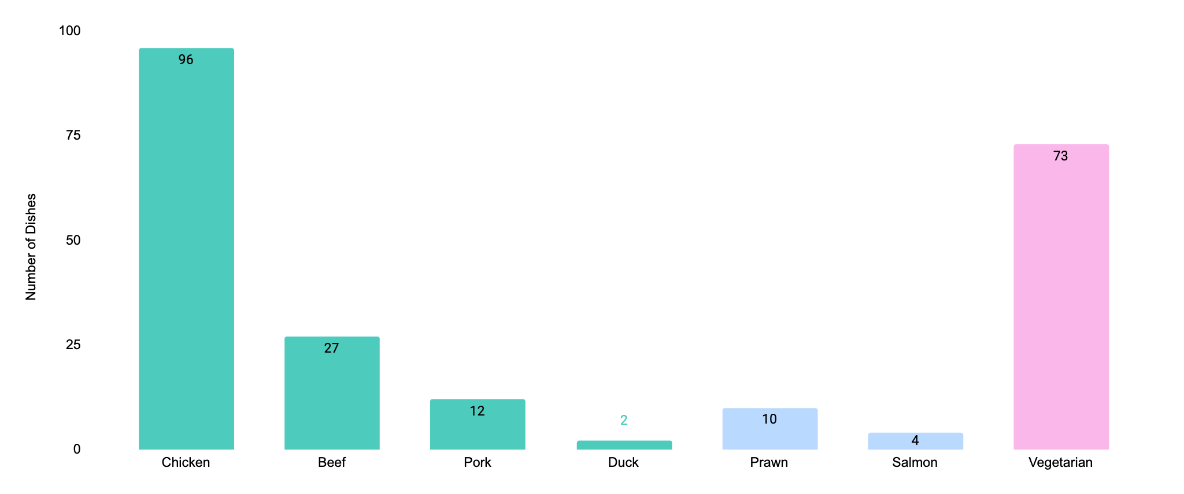
Chicken options dominate, while other meats, fish, and vegetarian choices are less well represented
Dish by Protein / Vegetarian Option (# Dishes)
As at 12-Dec
Meat
Fish
Veg
1. Sums to >155 as certain dishes offer >1 protein / vegetarian option

